Slide 1
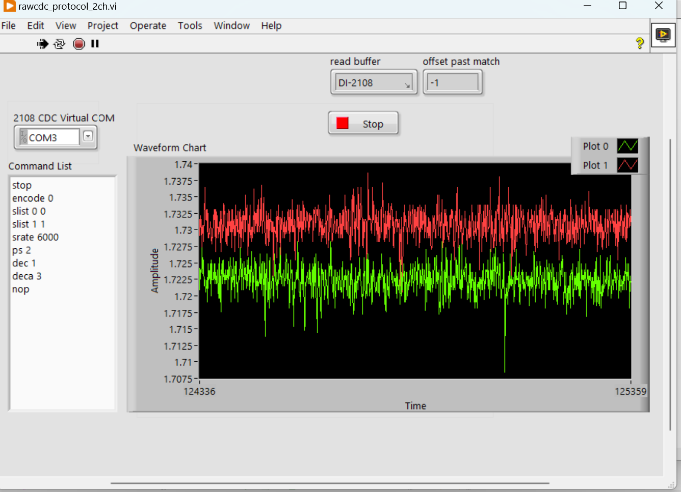
Raw Analog Data Noise < 0.01V of 10V FS

Slide 2
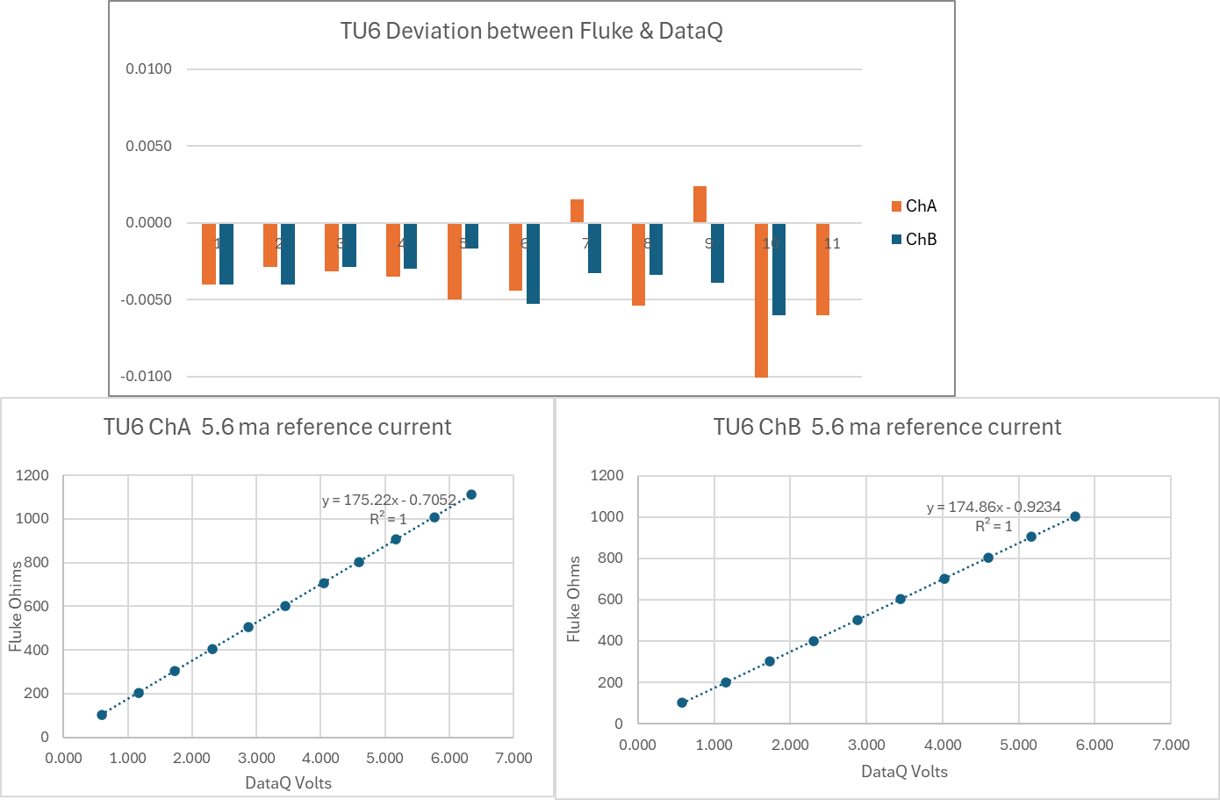
Measure of Resistance

Slide 3
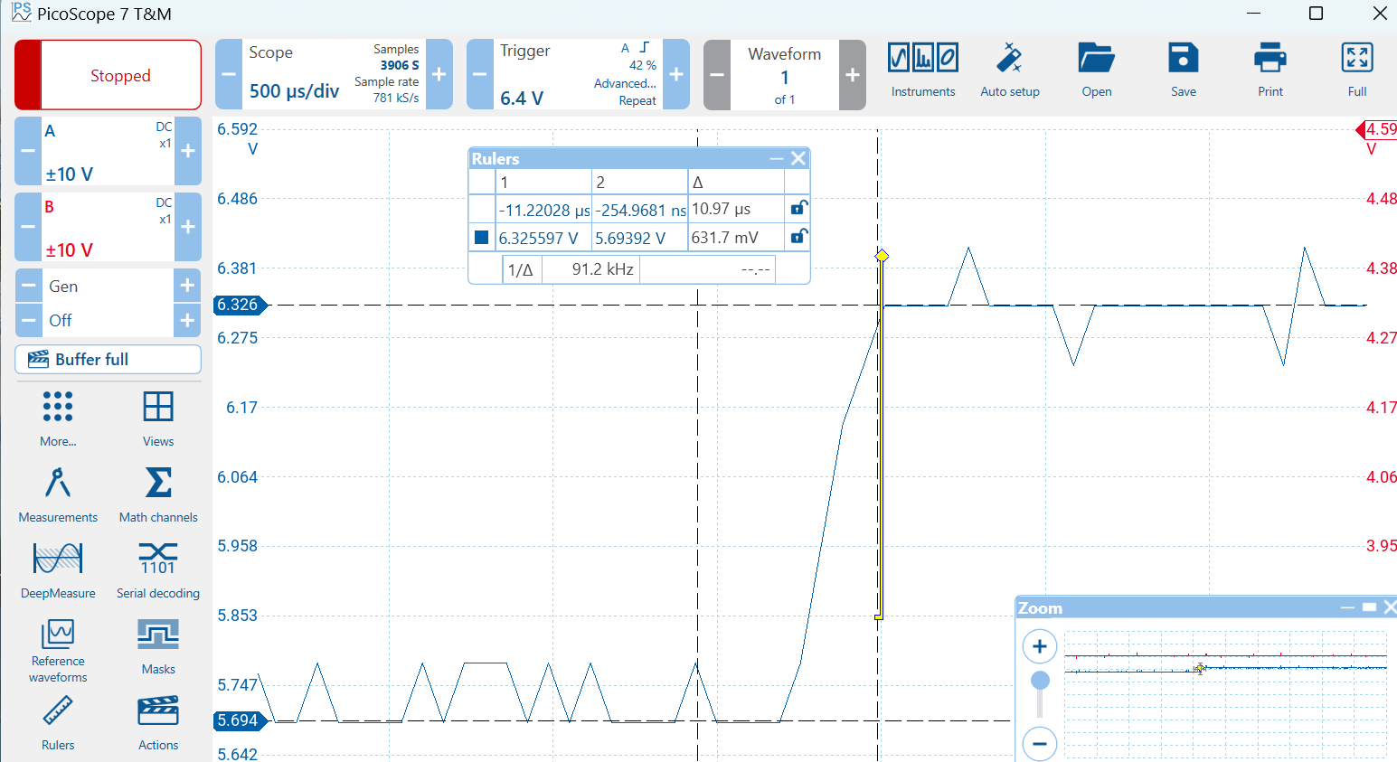
Switch Transition < 11 us

Slide 4
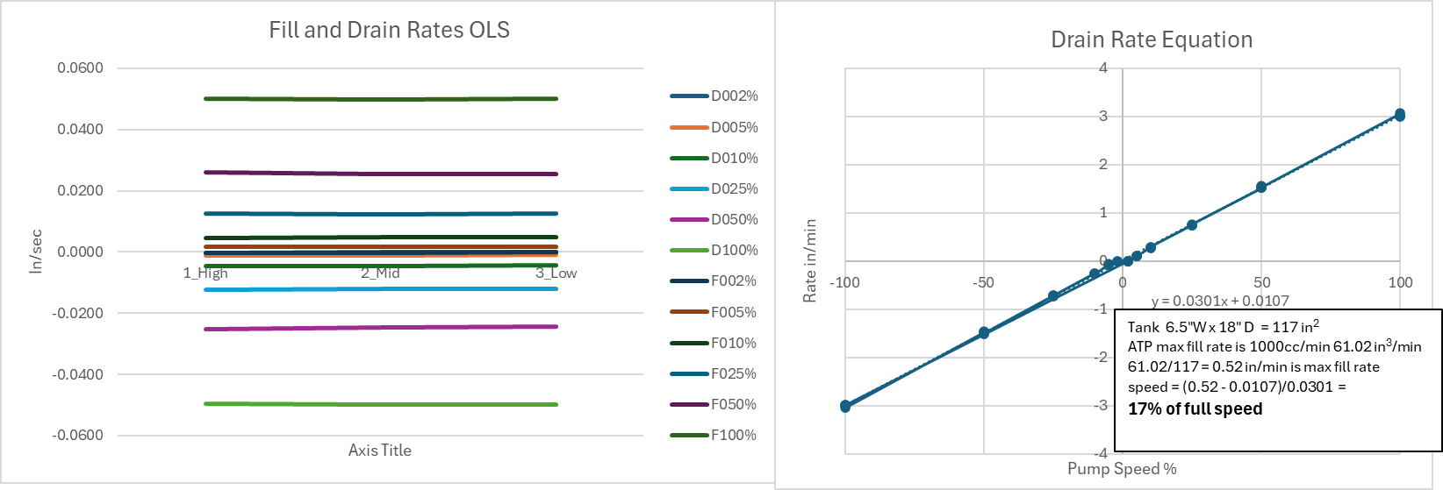
PWC OLS Tank Fill/Drain Speed
ATP Target Rate
There are 42 measurements at 7”, 5” 3” as High, Med, Low
D= Drain; F=Fill followed by % of full speed.
Regression on all 42 points
Fills slightly slower than it Drains.

Slide 5
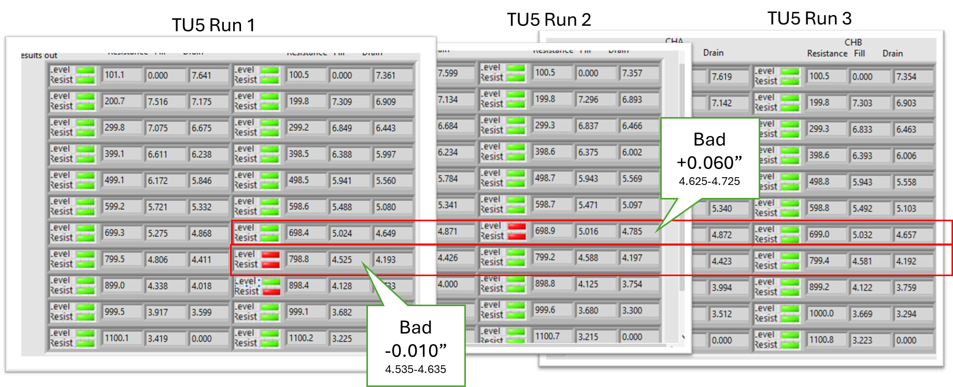

Slide 6
Descriptive Statistics

Slide 7
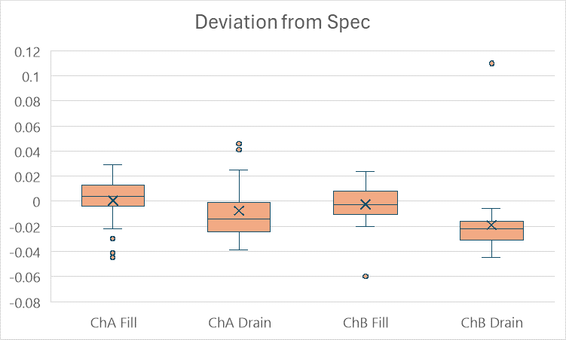
Box & Whisker Plot of Columns D1-3 of Descriptive Stats.
Bad
+0.060”
4.625-4.725
Outliers
USL
LSL
Outliers
Bad
-0.010”
4.535-4.635

Slide 8
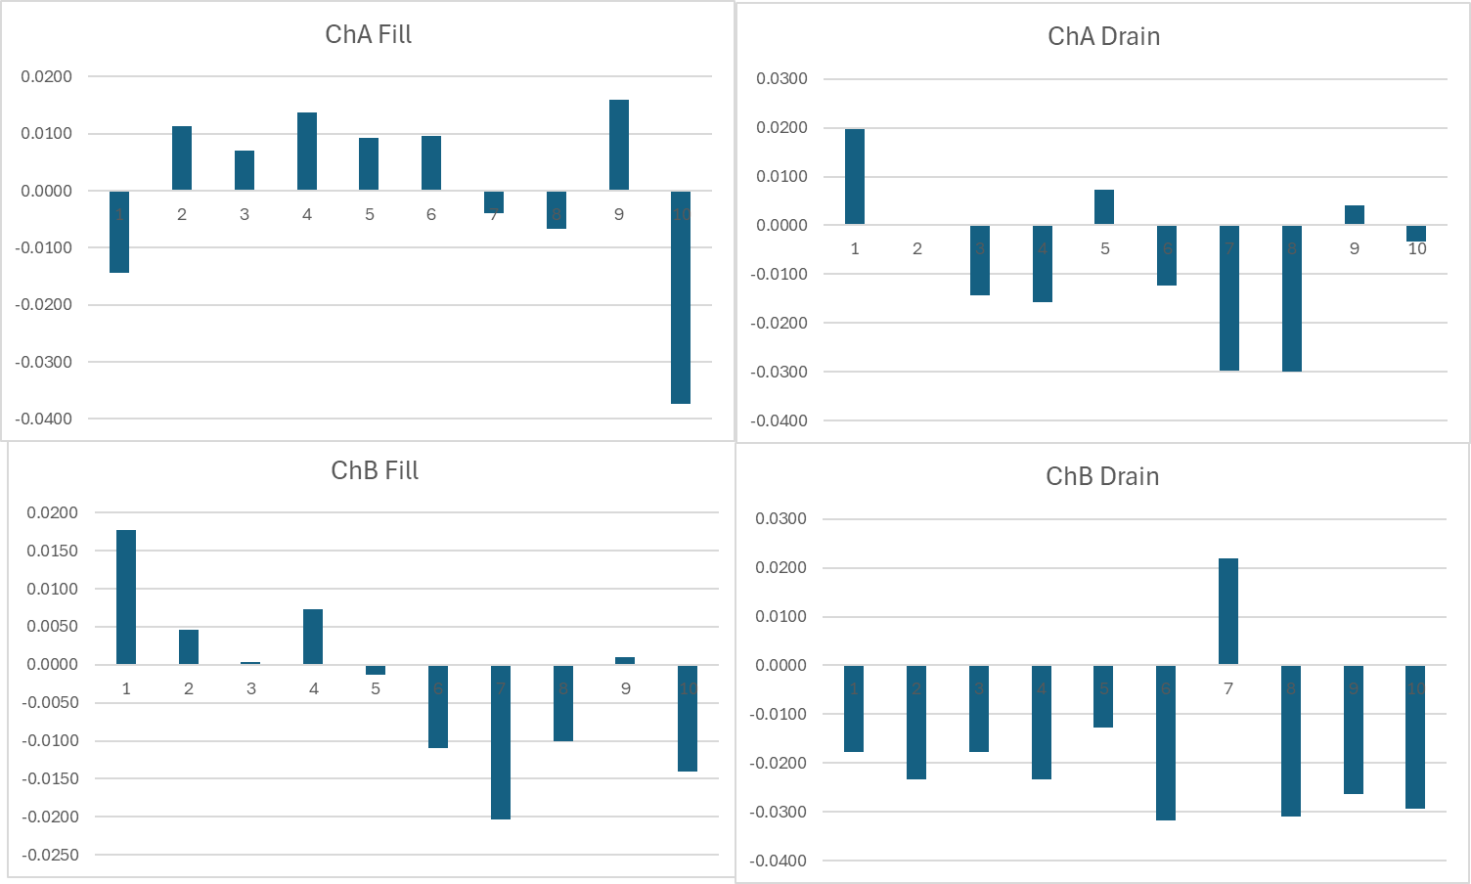
Each bar represent the deviation of three measurements average from spec for each reed switch in TU5

Slide 9
